Slide 1

BITCOIN TREND ANALYSIS
GROUP 8:
Prakyath Davanam Praveen
Rujuta Mirajkar
Yuktha Lakshmi A B

Slide 2
PROJECT OVERVIEW
The primary aim of this project is to conduct a thorough trend analysis of Bitcoin's price and trading activity on the Bitstamp exchange from 2012 to 2020, utilizing historical data collected at one-day intervals. This analysis seeks to answer key questions about Bitcoin's historical performance and understand the factors influencing its trends over time.
Methodology:
The project will involve the extraction and analysis of historical Bitcoin data from Bitstamp exchange, with a focus on implementing big data analytics techniques.
Significance:
Informs investment decisions and contributes to cryptocurrency market understanding. Analyze Bitcoin trading volume in BTC to see how trading activity changed over time. Analyze any significant changes in trading activity and liquidity to determine whether they may have an impact on price patterns
Timeline:
The project is expected to span data from 2012 to 2020, with key milestones including data extraction, analysis, and visualization stages. Converting Unix timestamps to human readable form and note significant turning points

Slide 3
PREDICTION, INFERENCE AND OTHER GOALS
Prediction Goals:
Price Prediction:
Objective: Forecast future Bitcoin 'Close' prices.
Outcome: Insights for informed investment decisions.
Inference Goals:
Market Dynamics Understanding:
Objective: Extract insights from historical data.
Expected: Holistic understanding of market influences.
Risk Mitigation Guidance:
Objective: Guide risk-aware investment decisions.
Expected: Identify potential risks for mitigation.

Slide 4
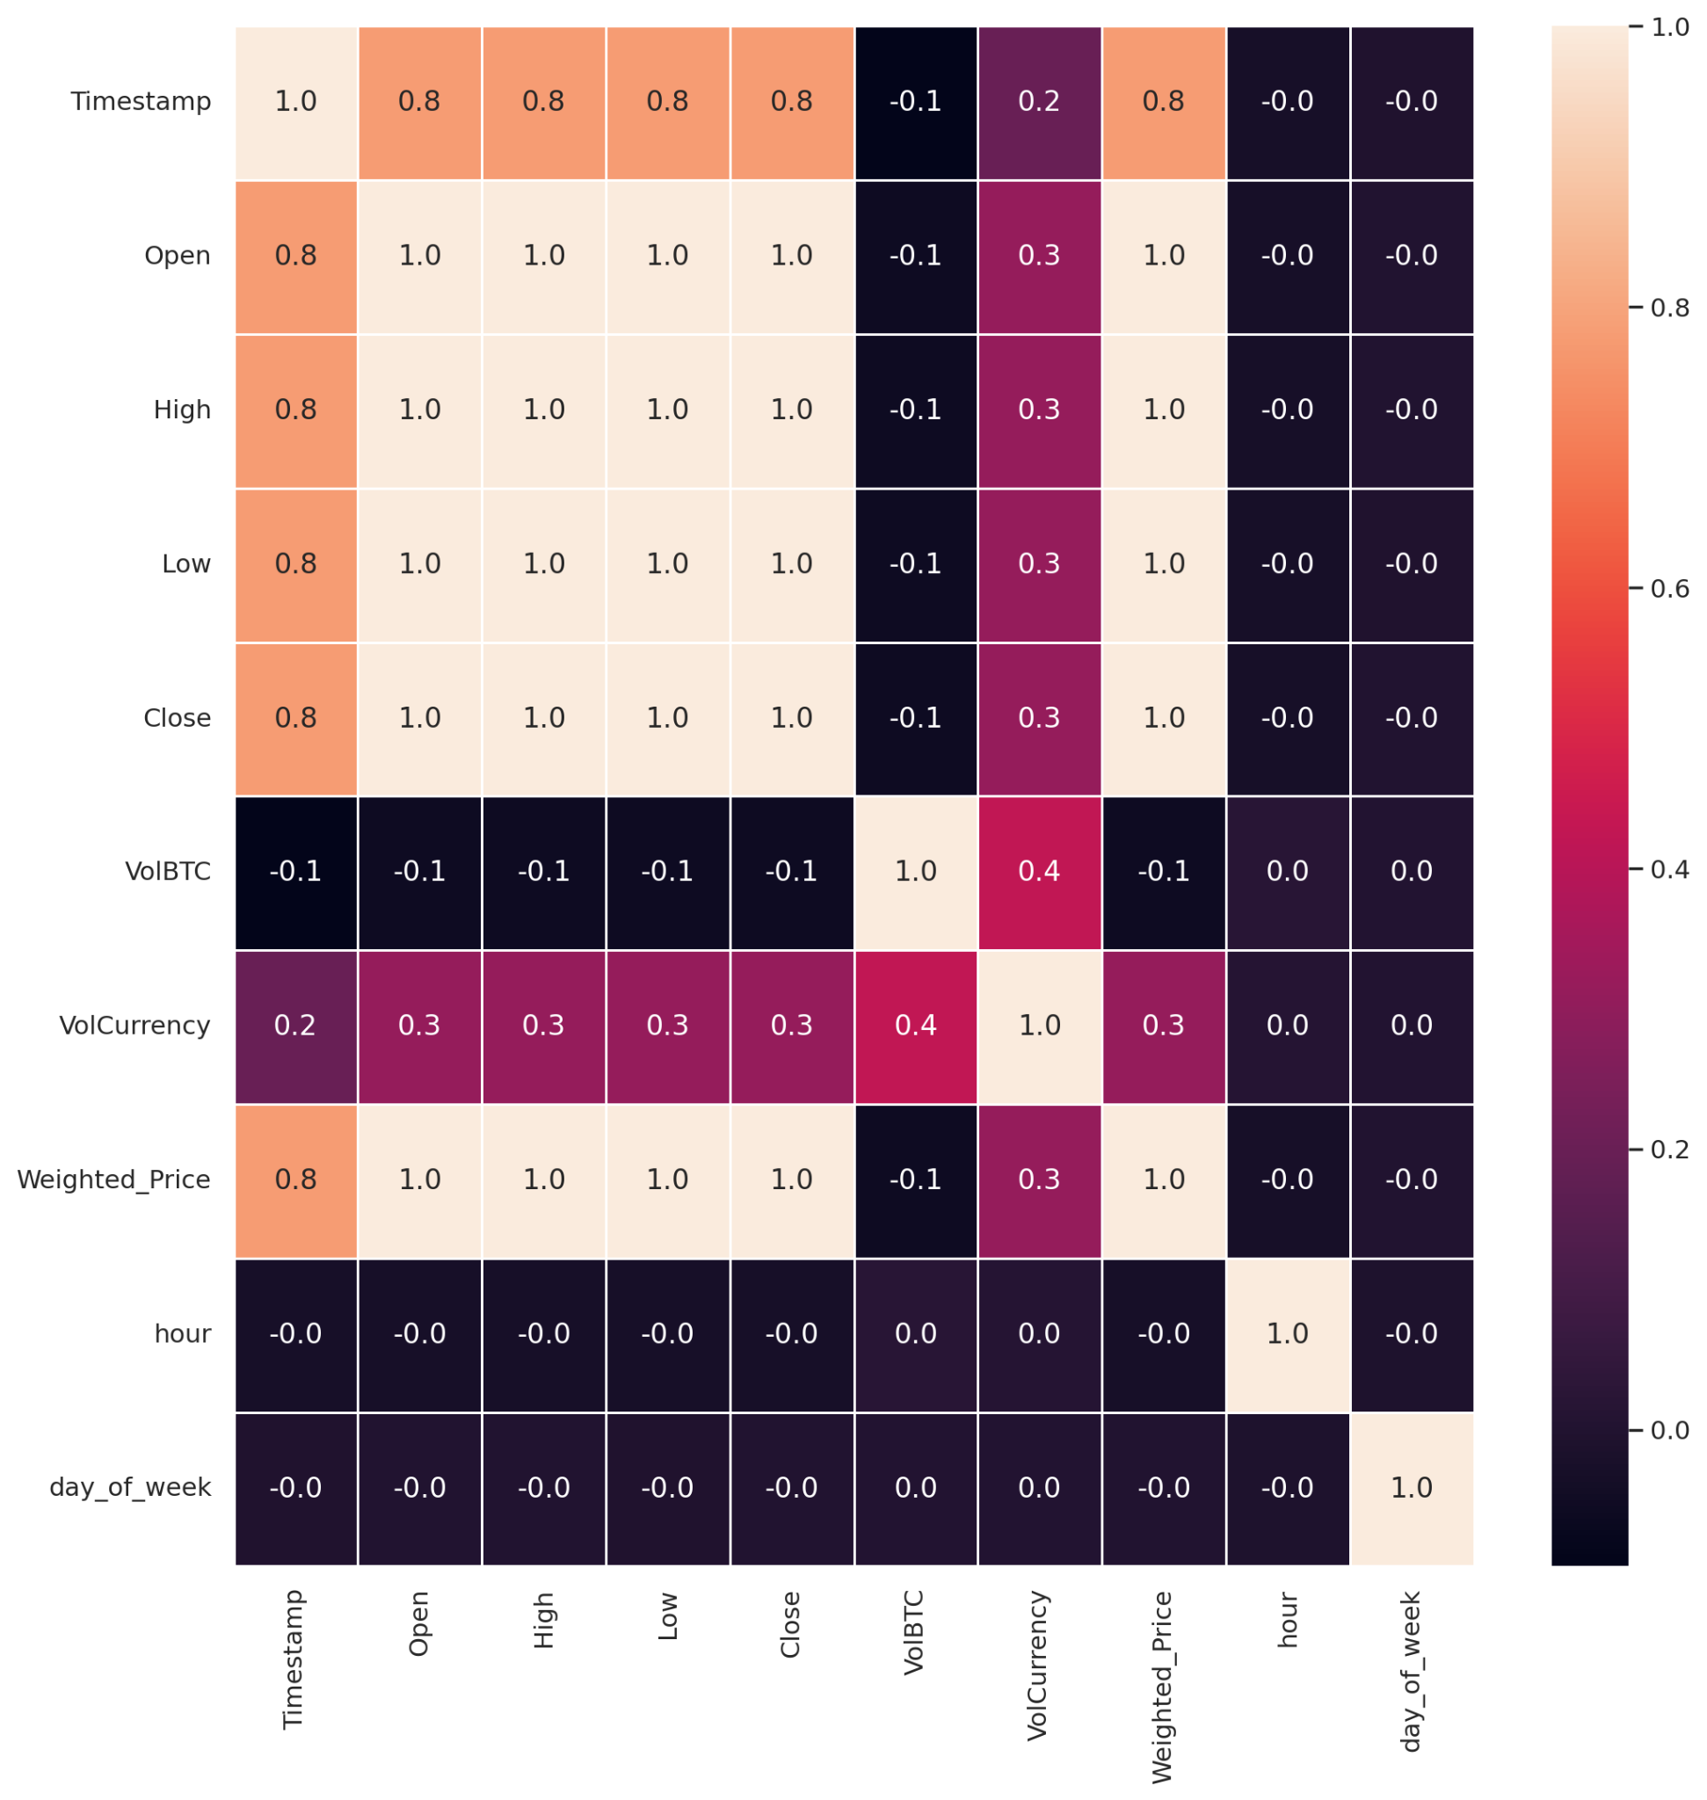
DATA EXPLORATION
In order to begin data exploration, we looked at the relationships between the various kinds of data. A visual representation of correlation from 1 to -1 is shown in the heat map below. A positive 1 indicates that the two variables are positively coordinated. Inverse coordination of the variables is indicated by a negative -1.
Data Transformation step included with converting Unix time stamp to
Date and time timestamp using spark SQL
Splitting the data frame with required columns for prediction( Vol_BTC,
Vol_Currency, Open, Close, High, Low, Date, Day_of_week, year)
Converting the spark dataframe to pandas data frame to know the
correlation between the variables and performing Data visualizations

Slide 5
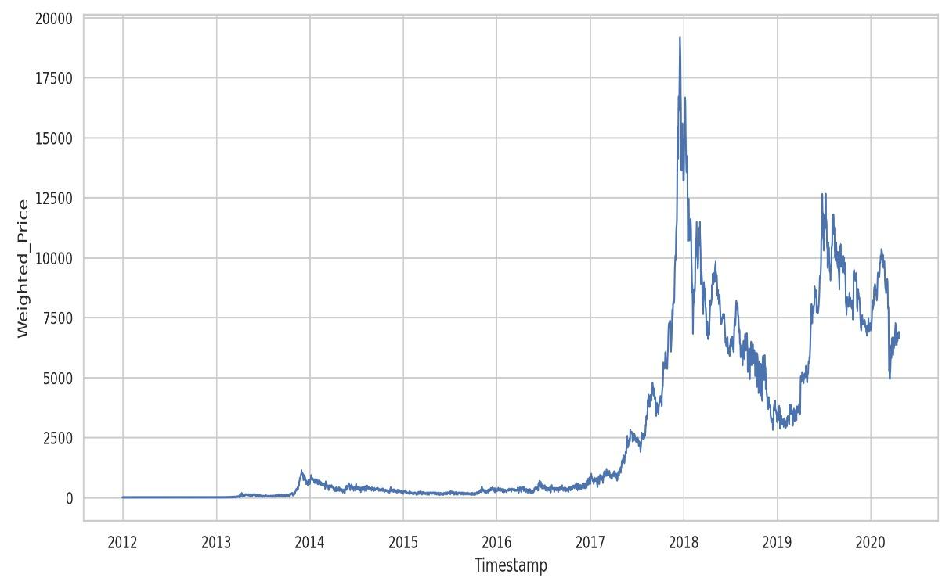
DATA EXPLORATION
Analysis of price trends:
The bitcoin weighted price reached its peak at 2017 and there was an abrupt decline in the price the following year 2018.
Starting from a relatively low value in 2012, there is a general upward trend, especially notable from around 2017
There are prominent peaks visible in the graph, particularly one around the end of 2017 and early 2018, which corresponds to a well-known cryptocurrency boom where Bitcoin reached its (at the time) all-time high.

Slide 6
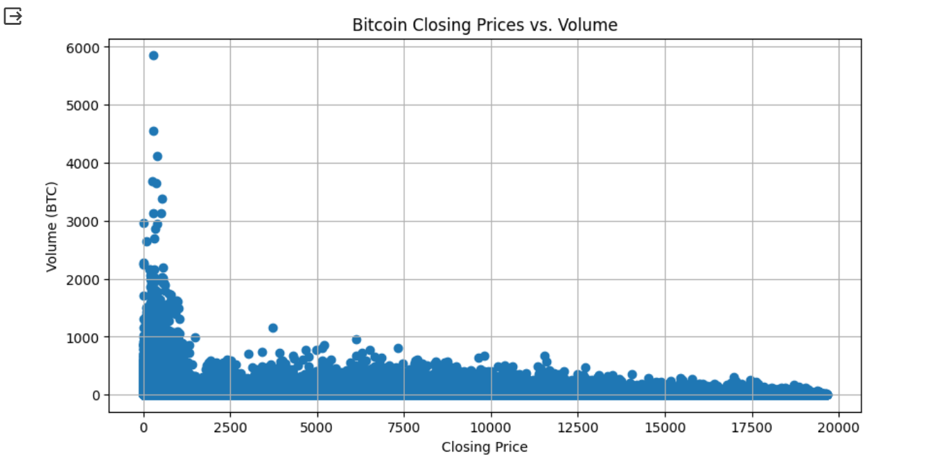
DATA EXPLORATION
Scattered plot:
Bitcoin Closing Prices Vs Volumn and the volume is considered in terms of BTC.
Higher volume trades are less common.
The widespread of volume across different price points might suggest varying degrees of market volatility over time

Slide 7
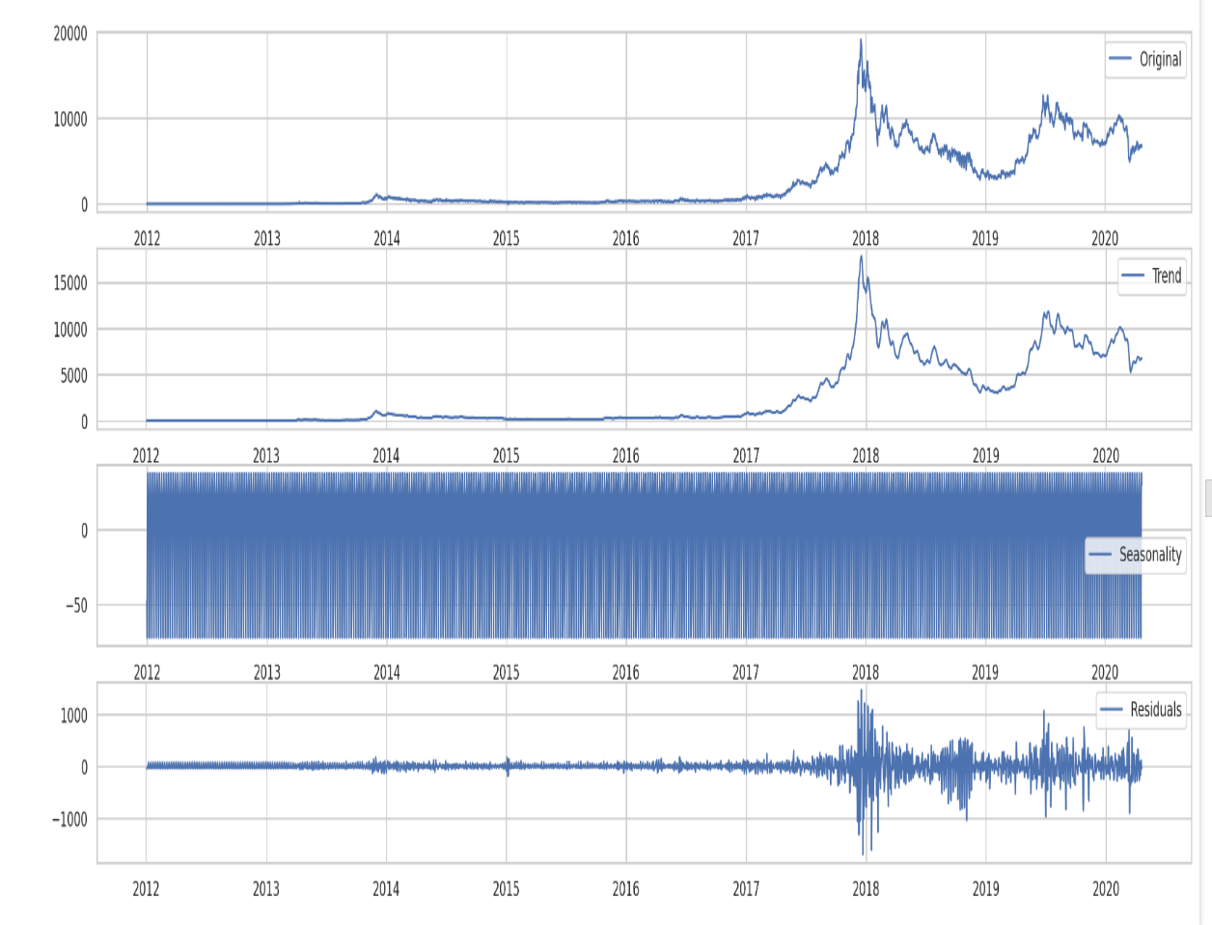
DATA EXPLORATION
The trend represents the long-term progression of the series. In essence, it captures the underlying growth or decline in the dataset over time, ignoring the short-term fluctuations.
Seasonality are the predictable and recurring patterns observed within a particular time frame, such as days, weeks, months, or quarters. The pattern appears to be highly regular and very frequent, suggesting a short seasonality period.
The residual component contains all the random fluctuations, noise, and unexplained variability in the data. These are the factors that are not accounted for by the identified trend and seasonality. Residuals can be thought of as the "unpredictable" part of the data.

Slide 8
INTERESTING RESULTS
ARIMA Model:
The ARIMA model has an RMSE of 2641.96. This indicates that, on average, the predictions of the ARIMA model deviate from the actual values by approximately 2461.96 units.
SARIMA Model:
The SARIMA model has an RMSE of 2157.77. This indicates that it performs slightly better than the ARIMA model, with lower prediction errors.
LSTM Model:
The LSTM model has an RMSE of 7480.22. It appears to have higher prediction errors compared to the ARIMA and SARIMA models.
Gradient Boosting Regressor Model:
The Gradient Boosting Regressor model has an RMSE of 2436.63. It performs similarly to the ARIMA model in terms of prediction errors.

Slide 9
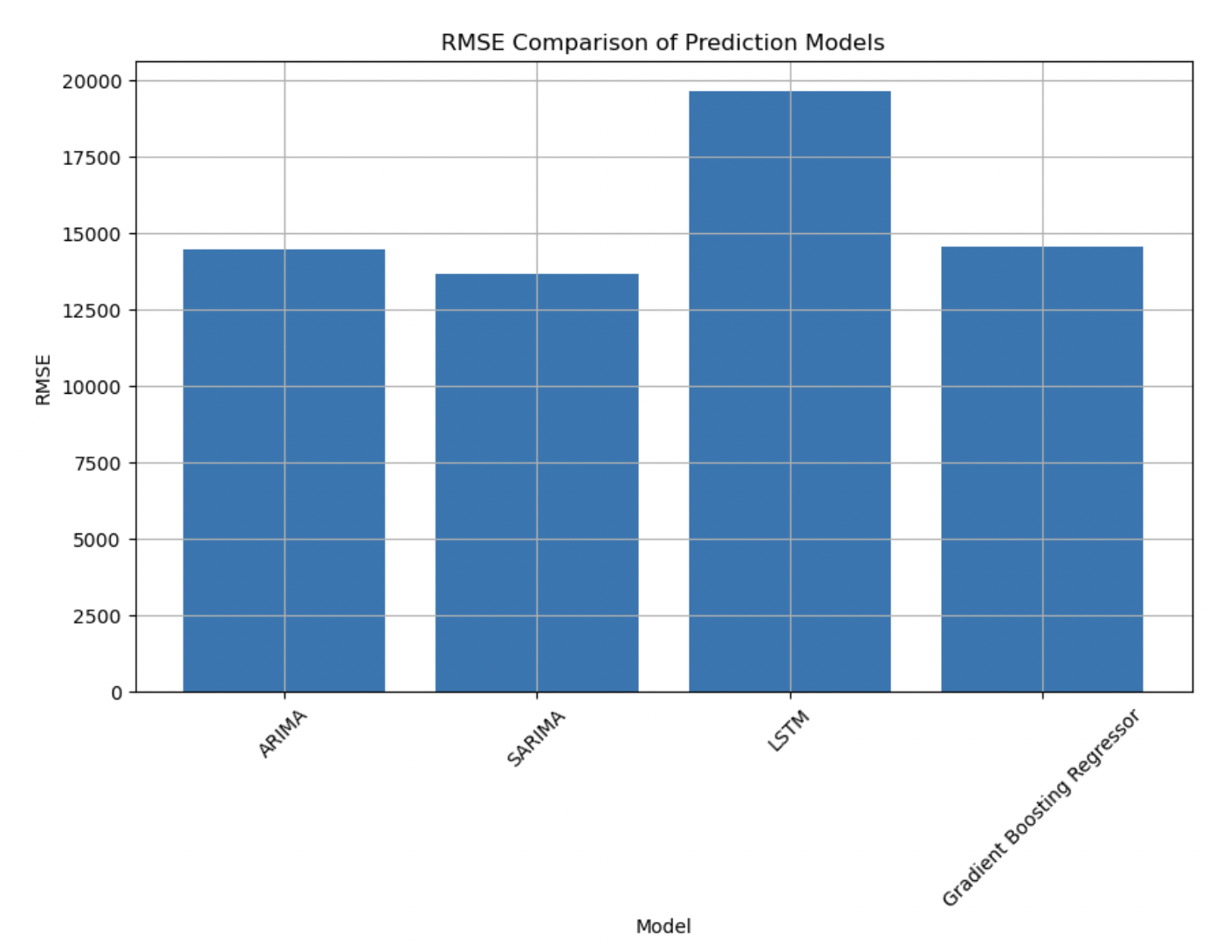
INTERESTING RESULTS

Slide 10
FEEDBACK FROM LAST PRESENTATION
Aggregating min-min interval to day-to-day interval of bitcoin data extraction from Bitstamp
Predicting the close price sequentially for next 10 days.
Implementing time series analysis on bitcoin price trends.

Slide 11
METHODS USED
ARIMA METHOD:
ARIMA is a time series forecasting model that combines autoregression (AR), differencing (I), and moving averages (MA). It is used to predict future points in a time series based on its past values and trends.
SARIMA Model (Seasonal AutoRegressive Integrated Moving Average):
SARIMA extends ARIMA by incorporating seasonality into the model. It is particularly useful for time series data with clear seasonal patterns.
LSTM MOdel(Long Short-Term Memory):
LSTM is a type of recurrent neural network (RNN) designed for learning long-term dependencies in data sequences. It is often used in time series forecasting, natural language processing, and other sequential data tasks.
GRADIENT BOOSTING REGRESSOR MODEL:
Gradient Boosting is an ensemble learning technique where multiple weak models (typically decision trees) are combined to create a stronger predictive model.

Slide 12
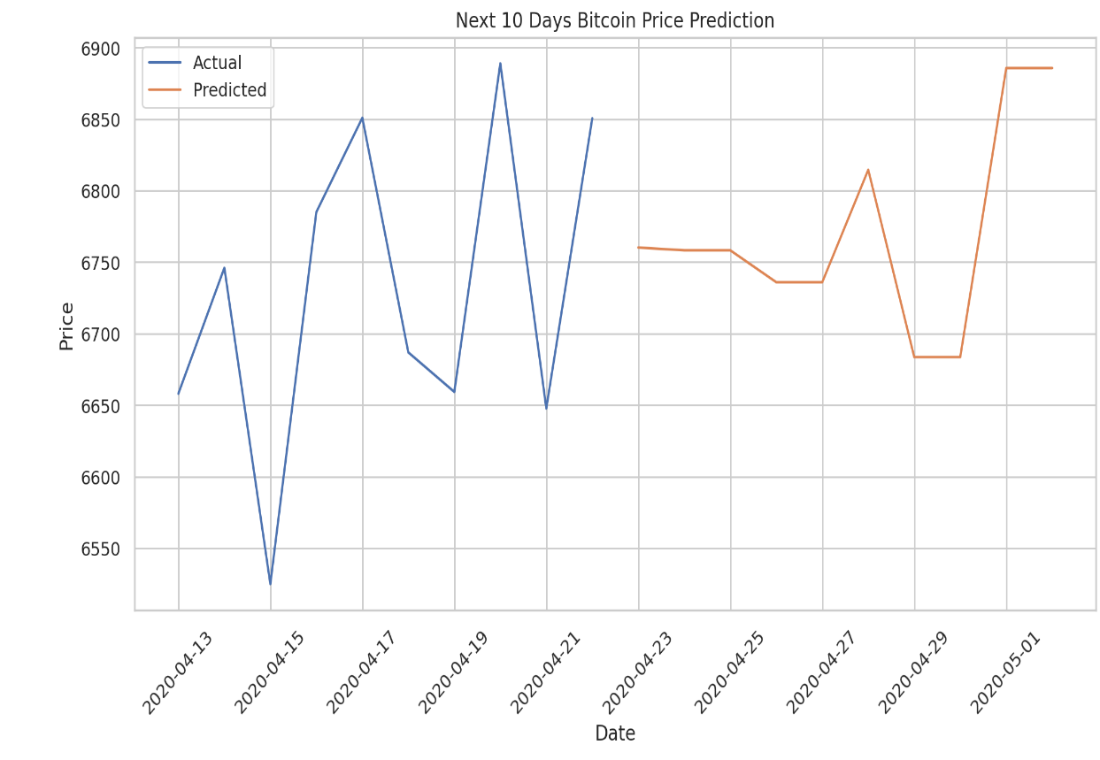
RESULTS
Our time series model is predicting Bitcoin closing prices for the 10-day period following April 13, 2020. The model utilized the last 15 days of available historical data to generate these forecasts.
Implemented sequential Analysis by taking past 15 days data to predict the price of future next 10 days.

Slide 13
PROBLEMS ENCOUNTERED
Missing Data:
Initial data exploration revealed missing values in 'Volume_(BTC),' 'Volume_(Currency),' and 'Weighted_Price.'
Strategies such as zero-fill and forward-fill were applied
Model Evaluation Challenges:
Comparing model performance across different time frames and assessing the significance of predictions posed challenges.

Slide 14
PREDICTION FOR FUTURE
Market Trends:
Analyze historical market trends. Understanding past patterns and trends can help identify potential future movements, although past performance does not guarantee future results.
Macroeconomic Factors:
Keep an eye on broader economic trends. Cryptocurrencies can be influenced by global economic conditions, inflation, and government policies. Understanding these factors can enhance prediction accuracy.
Forecasting Horizon:
Analyze the impact of changing the time horizon for Bitcoin price predictions. Consider short-term vs. long-term predictions and their respective accuracies.
Notes:
Summary of how well you achieved your prediction and inference goals. It is expected that you have not completed the project yet and this is an interim summary.

Slide 15
THANK YOU
THANK YOU

